Slide 1
What’s New in the WOCNext Exhibit Hall?
Stephanie Yates, MSN, RN, ANP-BC, CWOCN, WOCNF
stephaniesyates@gmail.com

Slide 2

TEN ACES MED https://tenacesmed.com/
Silicone-Based Medical Adhesive Spray
“It is our deep belief that everyone deserves to start, live & end every day filled with confidence.”

Slide 3
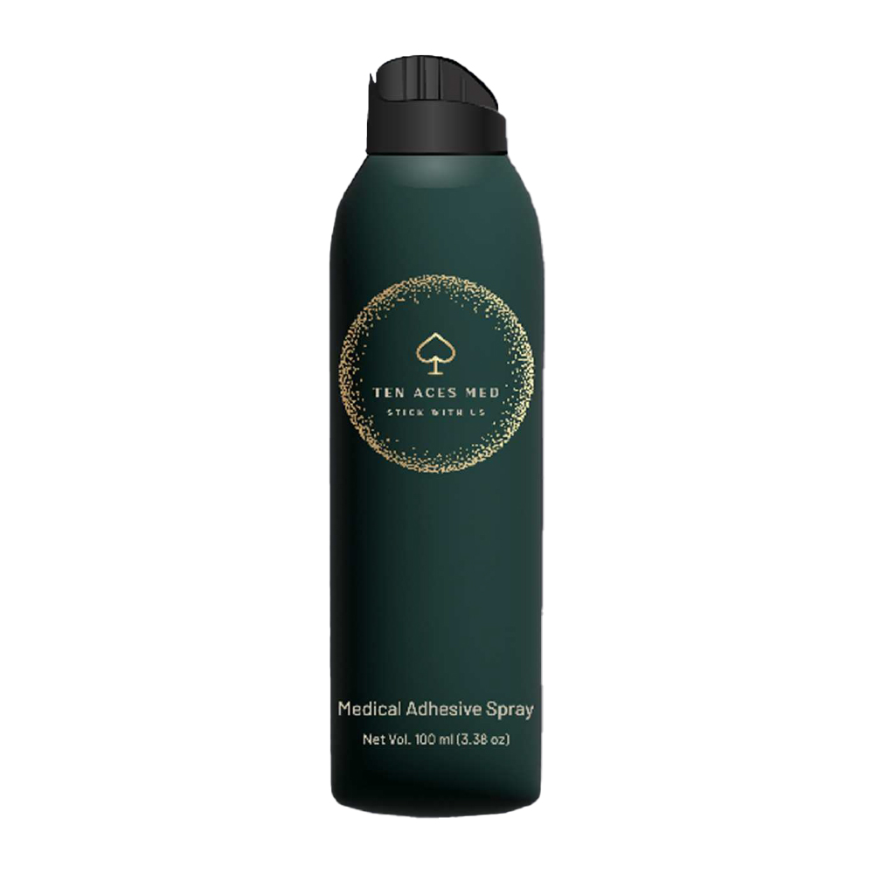
TEN ACES MED https://tenacesmed.com/
Replaces Hollister Medical Adhesive Spray #7730
Used on the skin barrier directly
NOT onto the skin
Must dry for 5 minutes prior to application

Slide 4

TEN ACES MED https://tenacesmed.com/
Can purchase from website – through Medical Monks and Mercy Supply Collaborative
Spray on the skin barrier directly
NOT onto the skin
Must dry for 5 minutes prior to application
Not Covered by Medicare or Insurance

Slide 5
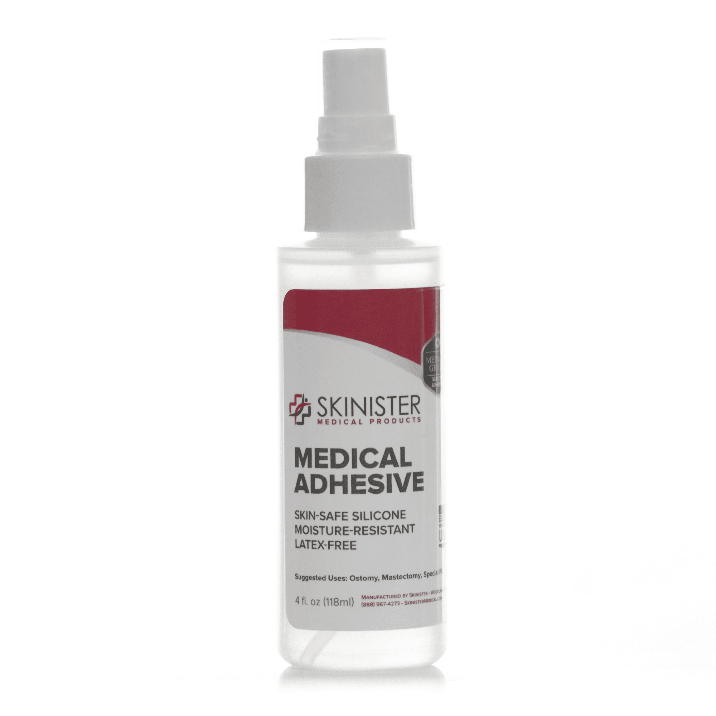
Skinister Medical Adhesive https://skinister.com/
Silicone pressure-sensitive skin adhesive
Water resistant to sweat, bathing, and swimming
Odor free
Latex free
Hypoallergenic
Non-aerosol

Slide 6
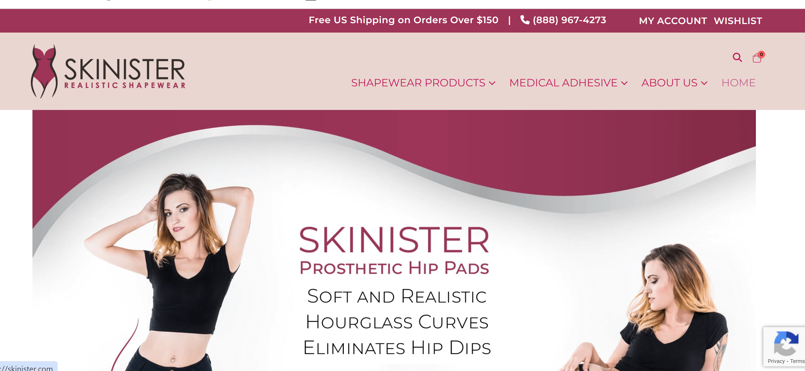
Skinister Medical Adhesive https://skinister.com/
Replacement for Hollister Medical Adhesive #7730
“Medical grade prosthetic adhesive spray”
Drying time is important to allow solvent to evaporate.
Press and hold firmly for a few minutes to form a more secure bond.

Slide 7
Skinister Medical Adhesive https://skinister.com/
To apply to clean DRY skin:
Spray Skinister Medical Adhesive to the device. A thin coat of adhesive is usually more effective than a thick coat.
A second coat may be applied if needed to device, or alternately the adhesive may be applied to healthy skin (avoid broken skin, wounds, or stoma in case of ostomies).
Allow to fully dry for 5 minutes before applying to skin.

Slide 8
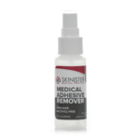
Skinister Medical Adhesive Remover https://skinister.com/
formulated to remove Skinister Medical Adhesive
odor-free, non-skin irritating and non-sensitizing

Slide 9
Skinister Medical Adhesive Remover https://skinister.com/
To use:
Apply with a brush, paper towel, cotton swab or other applicator
Gently work product under the edges
Rinse the skin and appliance (if reusable) with soap and water

Slide 10

https://revelostomy.com/
Revel is a brand dedicated to the 3 million people around the world living life with a stoma.
Our goal is to use technology to create products that make significant improvements in the lives of ostomates, and work alongside them as they build a welcoming and confident community that celebrates “living out loud.”

Slide 11
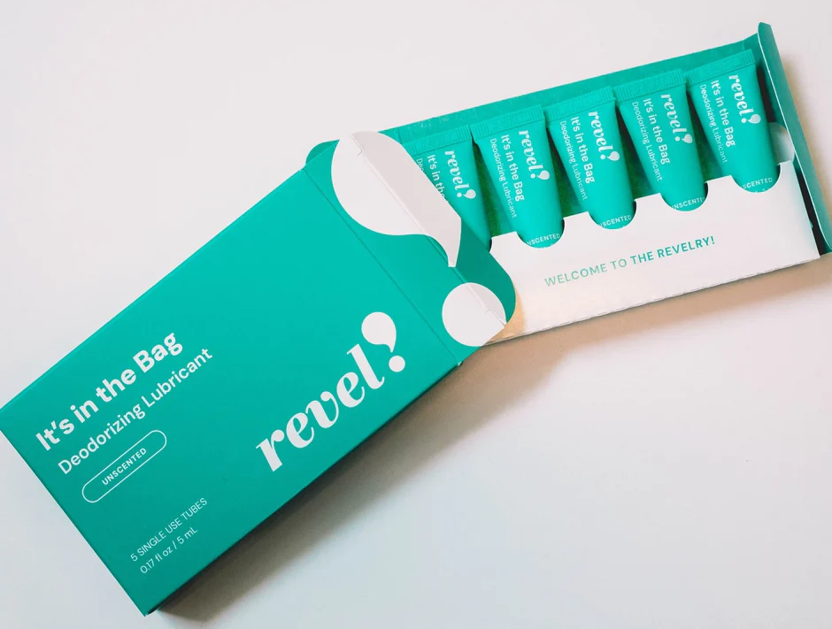

Revel!
Deodorizing lubricant
Available in unscented, lavender and eucalyptus
Available in 8 oz. bottles and 0.5 ml travel sizes

Slide 12
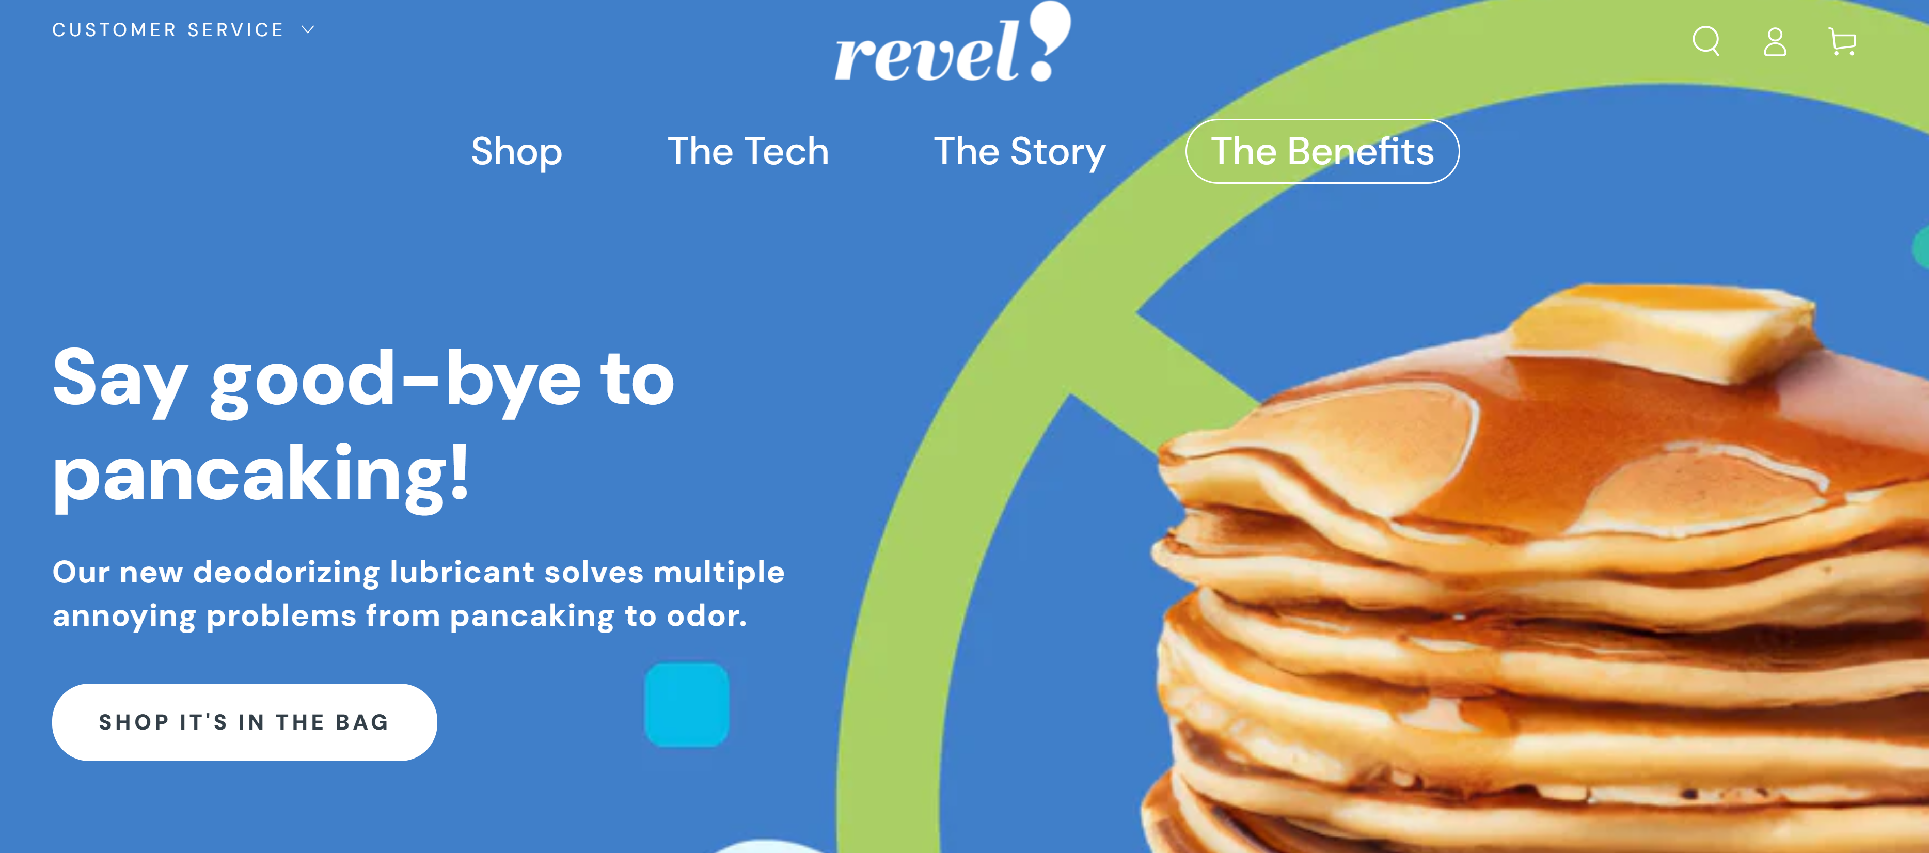
Revel! (Benefits page)

Slide 13
Sanitary Ostomy Drainage Device (SODD) – Foda Holdings Ltd.
bridges the gap between pouches and toilets, for any mobile upright patient to directly drain the waste contents into any toilet
https://docs.google.com/forms/d/e/1FAIpQLSfmsfxI4IGKpLUTApcOboTK-OLMBIBrQgahxuNVV9cFFVFQjw/viewform

Slide 14
Suportx, Inc. https://suportx.co.uk/
UK based company
Manufacturer of innovative support garments for hernia prevention and support
Available in the US – Suportx Briefs, Shorts, and Stoma Secure

Slide 15
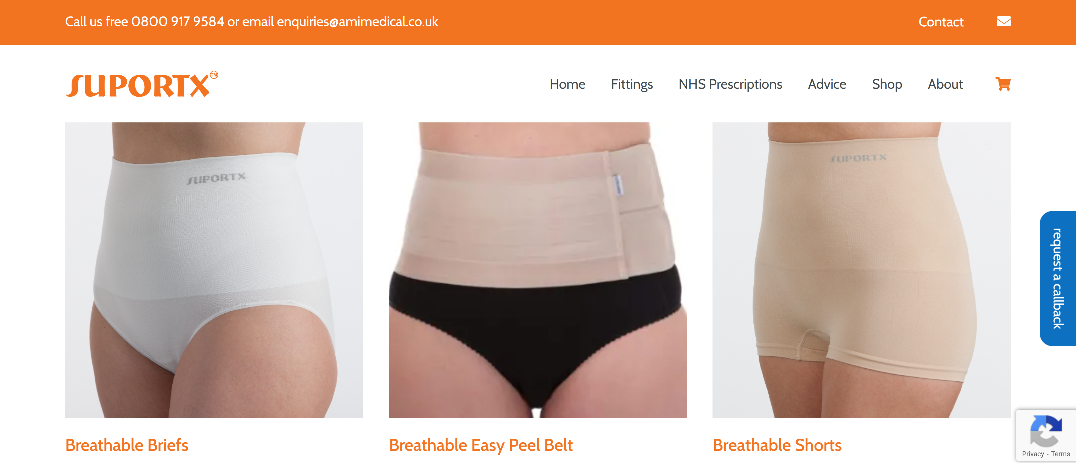
Suportx, Inc. https://suportx.co.uk/

Slide 16
Now you know what’s new! Maybe something that could help you!
Stephanie Yates
stephaniesyates@gmail.com

